Slide 1
Lab 4
EECE 5554 Yu Shun Lin

Slide 2
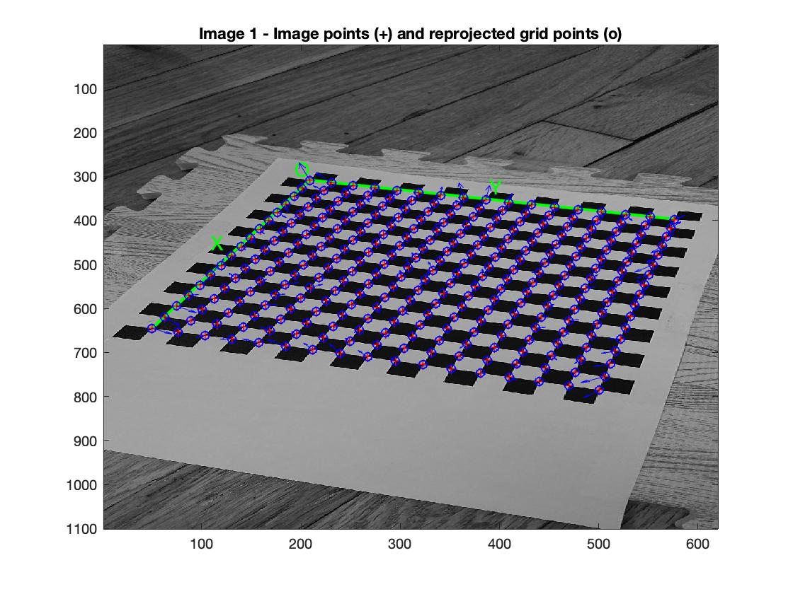
Projection of the black white board
Reprojection of the black white board of SONY XZ3 camera
Take 16*16 blocks each for 1mm
The image shows that the reprojection

Slide 3
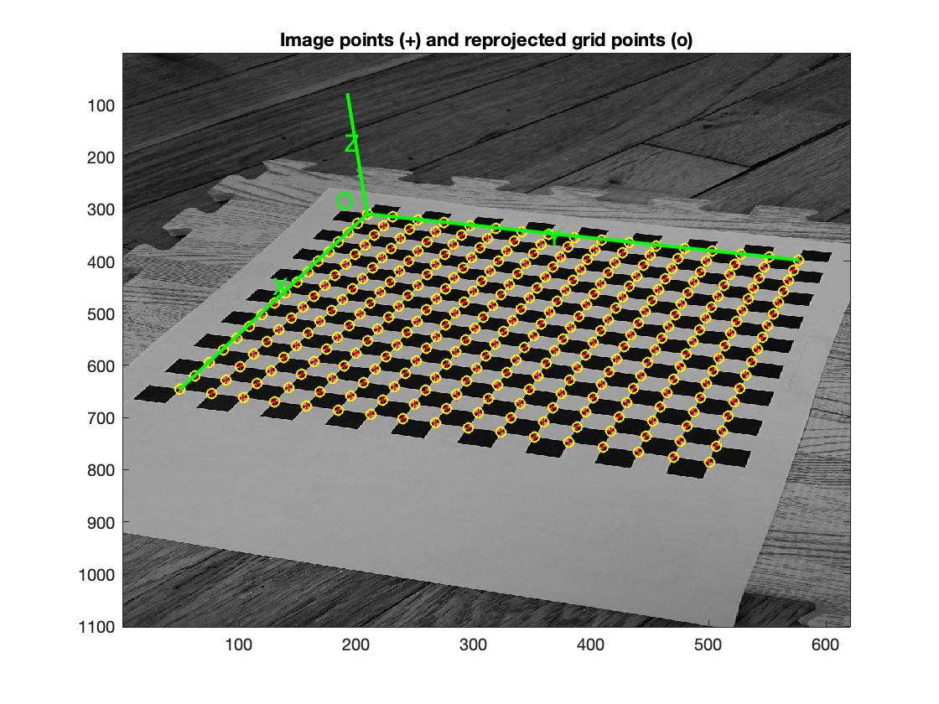
Projection of the black white board
The image show the Comp. Extrinsic of the black and white board
Each cross shows on the cross of black and white

Slide 4
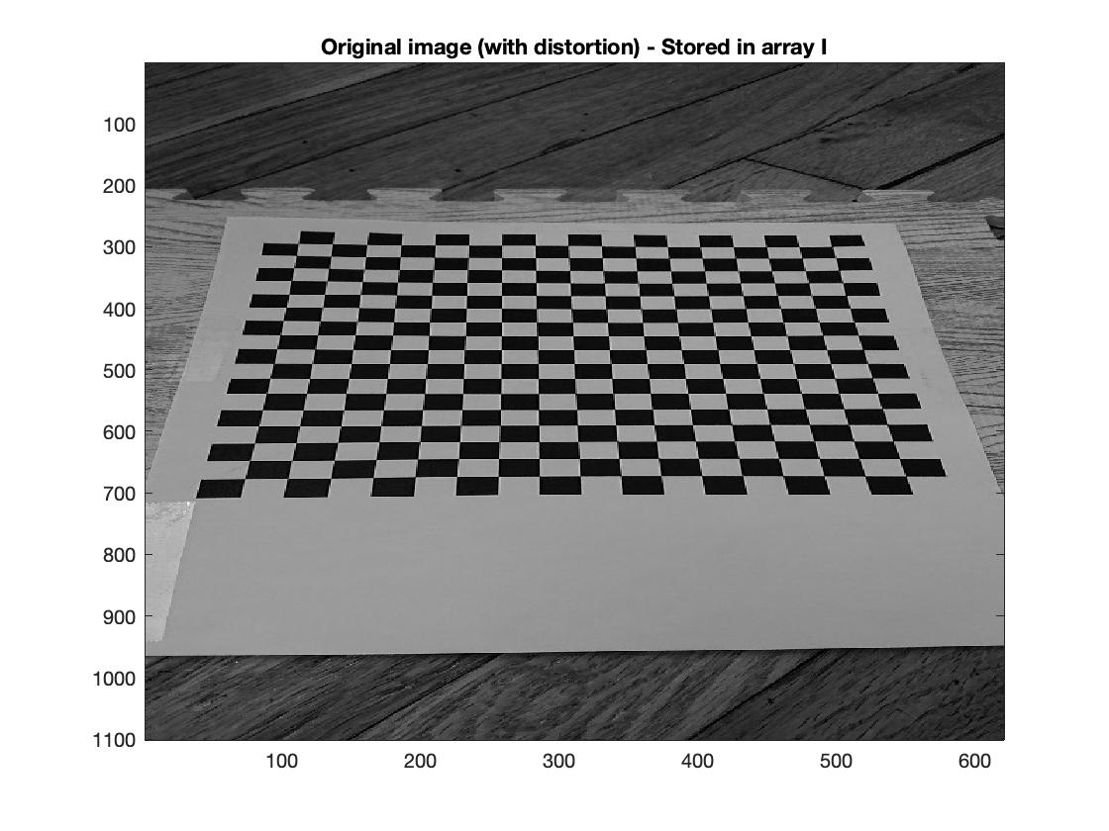
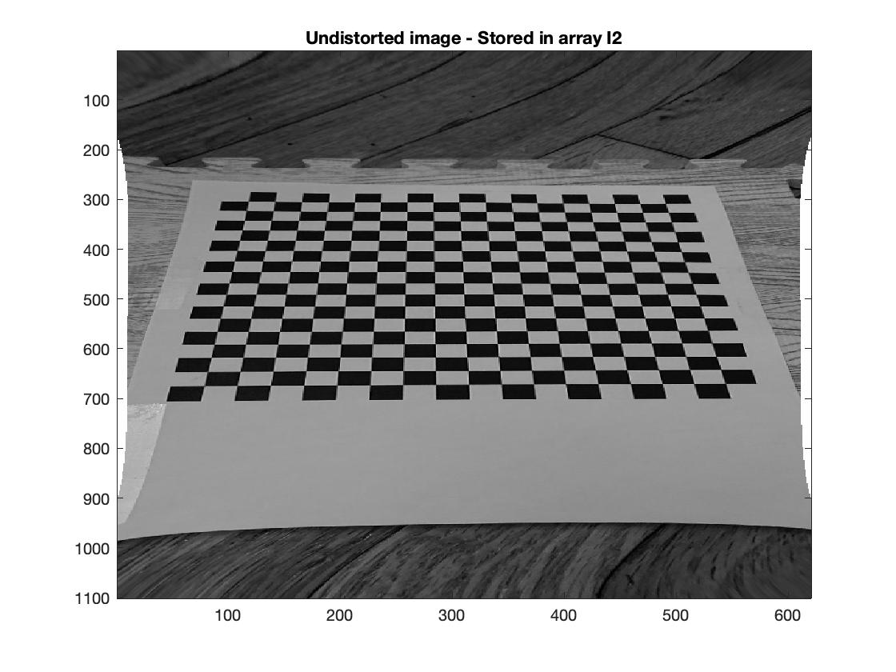
Undistorted image and Original image
The Undistorted image and the original image
Two images has obvious different that the original curve on edge of black and white board has been fixed in undistorted image
The edge of the image curve because of the fixing of the center black and white board

Slide 5
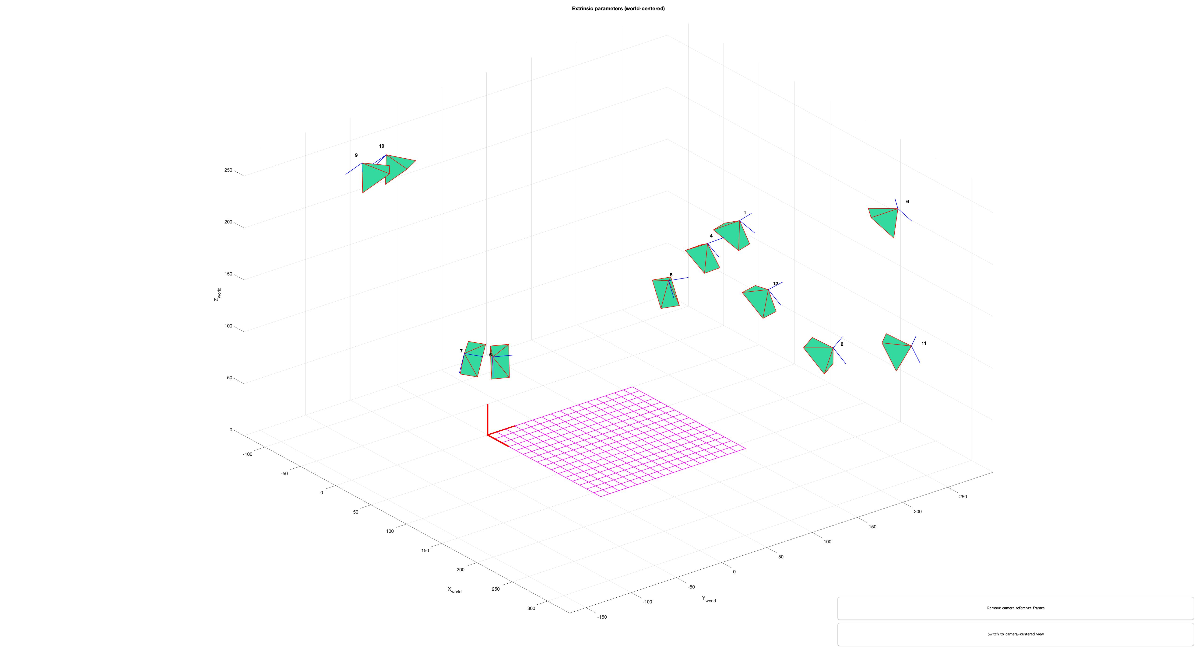
Position of the camera – black and white board
The image show that the position of the camera when taking picture of black and white board
11 pictures are took

Slide 6
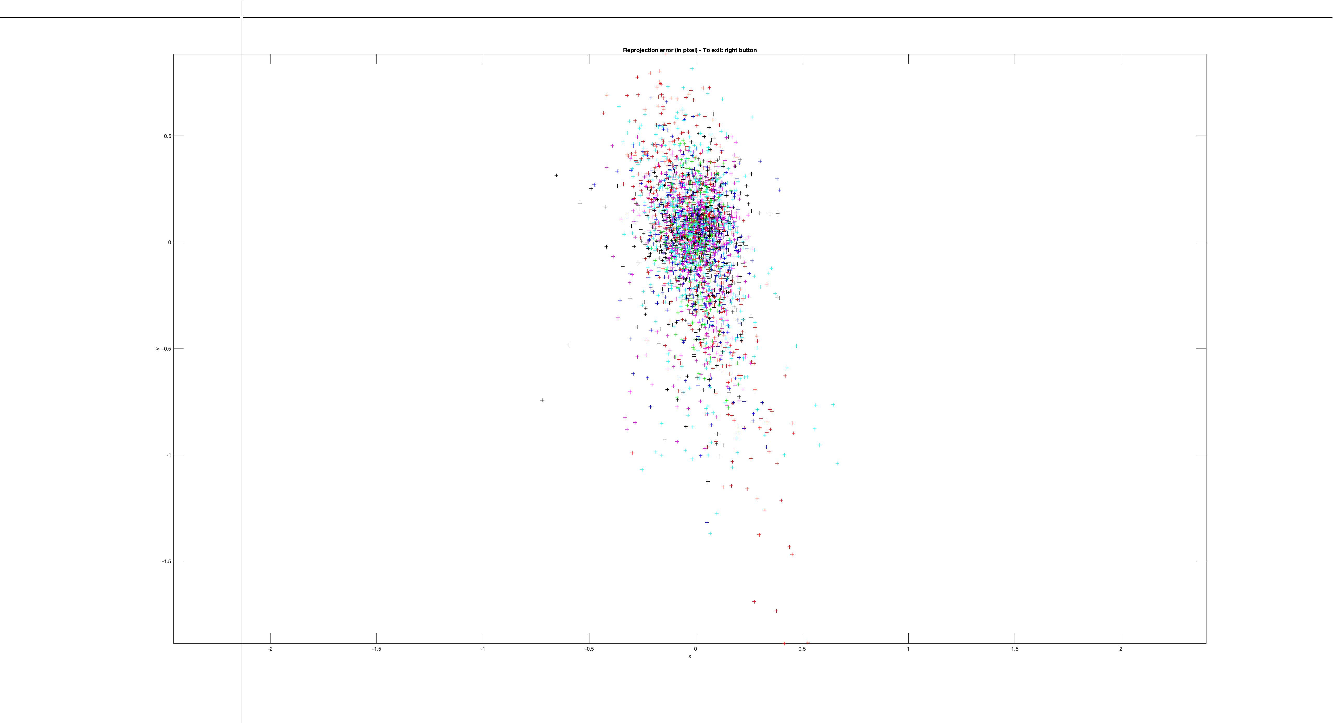
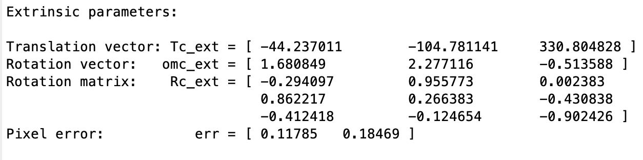
Projection error and mean error
The projection error of mean has been fixed by Extract grid corners, Recomp. Corners of 11 images
Pixel error shows that the value of the error is [0.11785 0.18469]

Slide 7
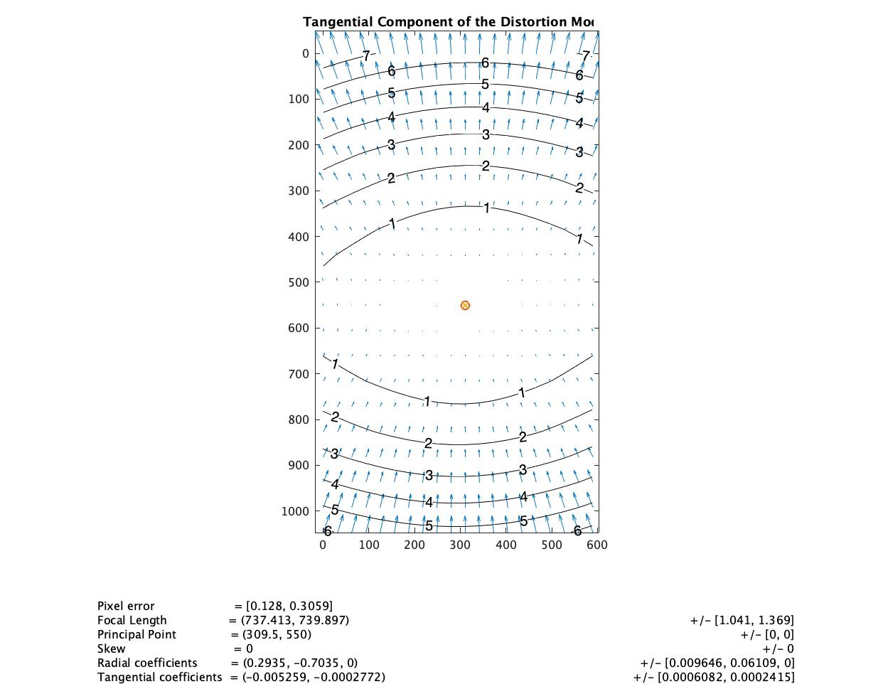
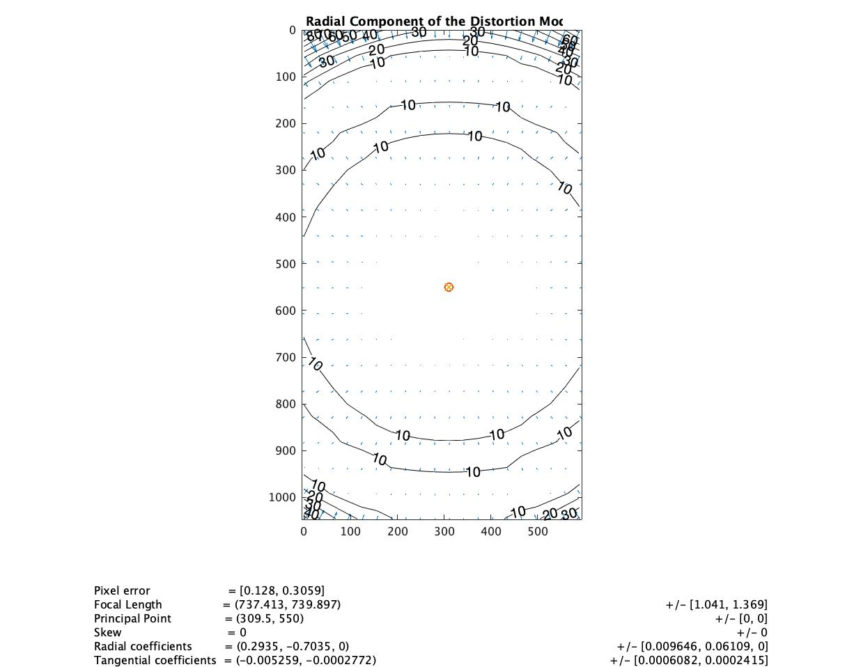
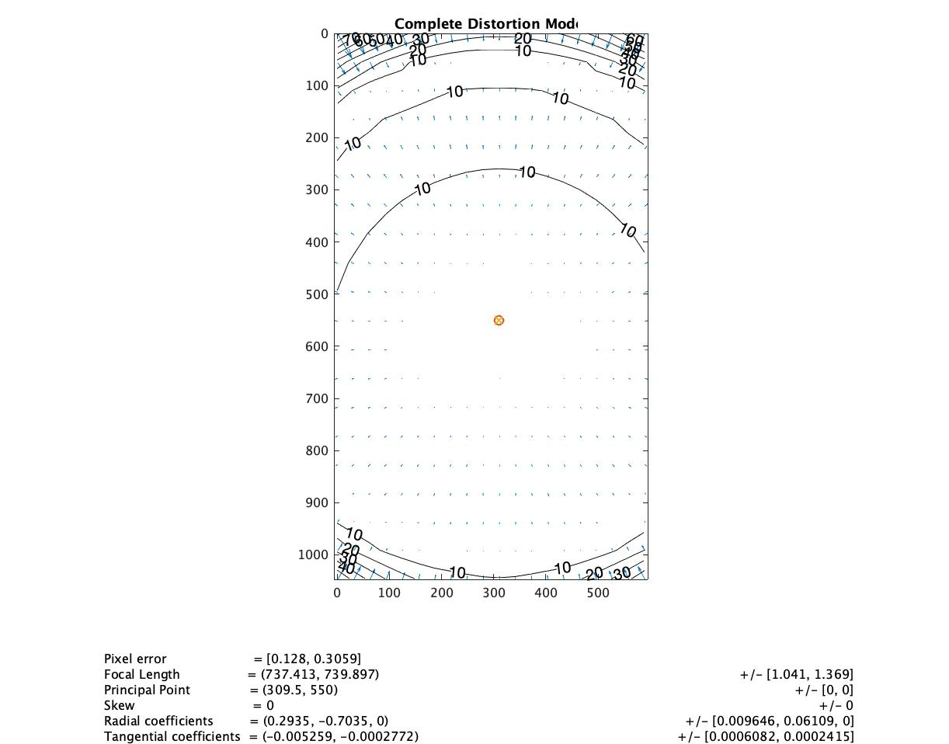
Visualize Distortion
The plots shows that the tangential, radial and complete distortion mod
After calibration, the image use these data to fix the distorted images

Slide 8
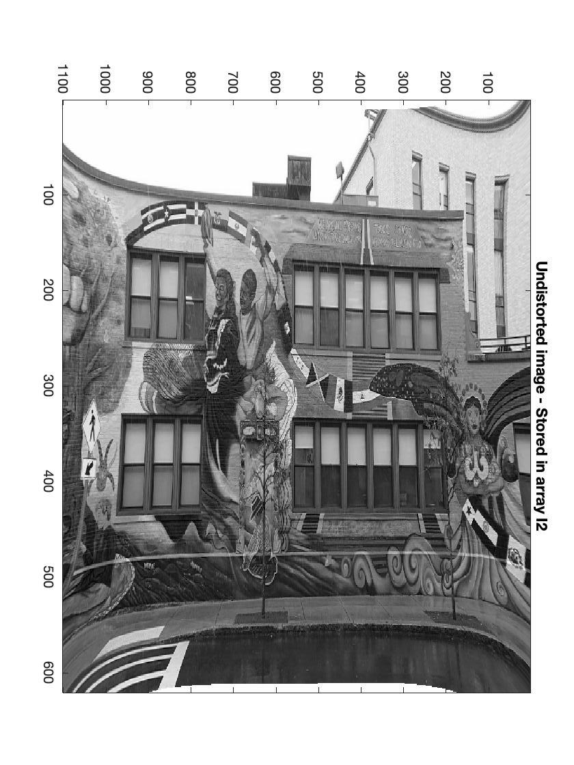
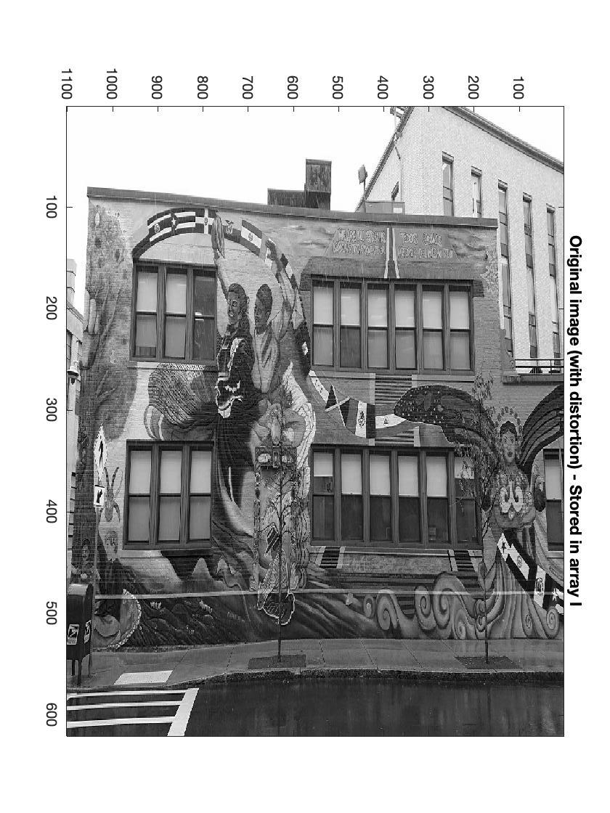
Undistorted image and Original image
Undistorted image and original image of the LSC building
Near center of the original image has been fixed
Thus the undistorted image edge will have some curve

Slide 9
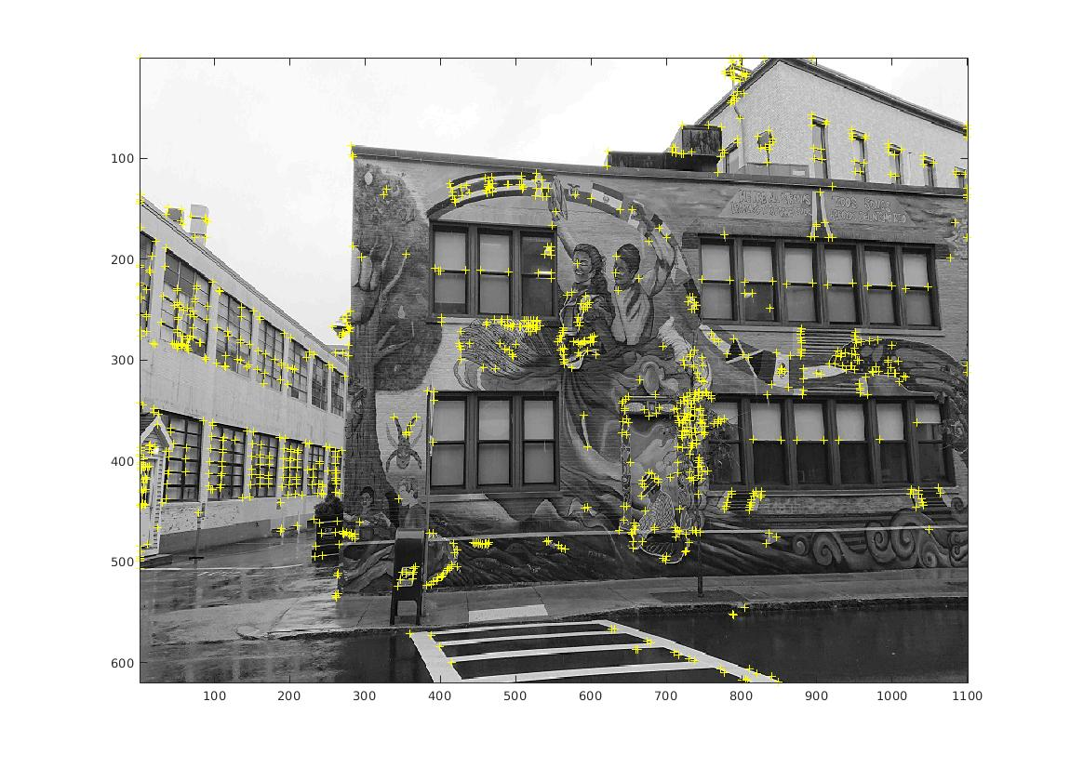
Harris.m
Harris.m is the detector for corners
The image shows the corner of the building image
The image collect for 1000 points

Slide 10
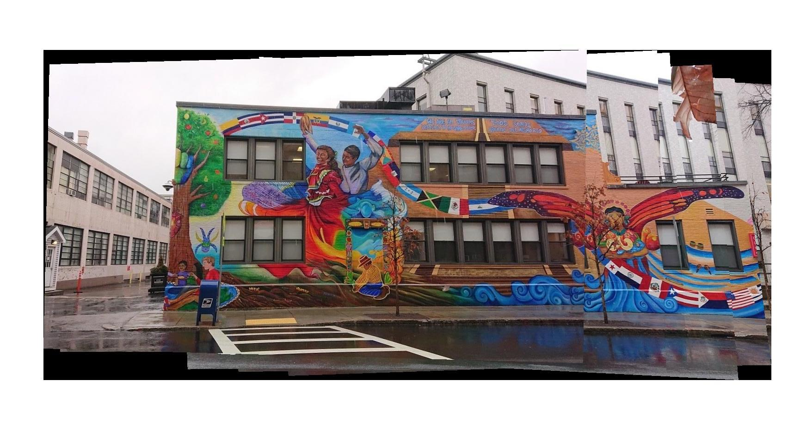
Composite mosaic - LSC
Composition image of LSC building
Composite by harris.m
Graffiti art are connected

Slide 11
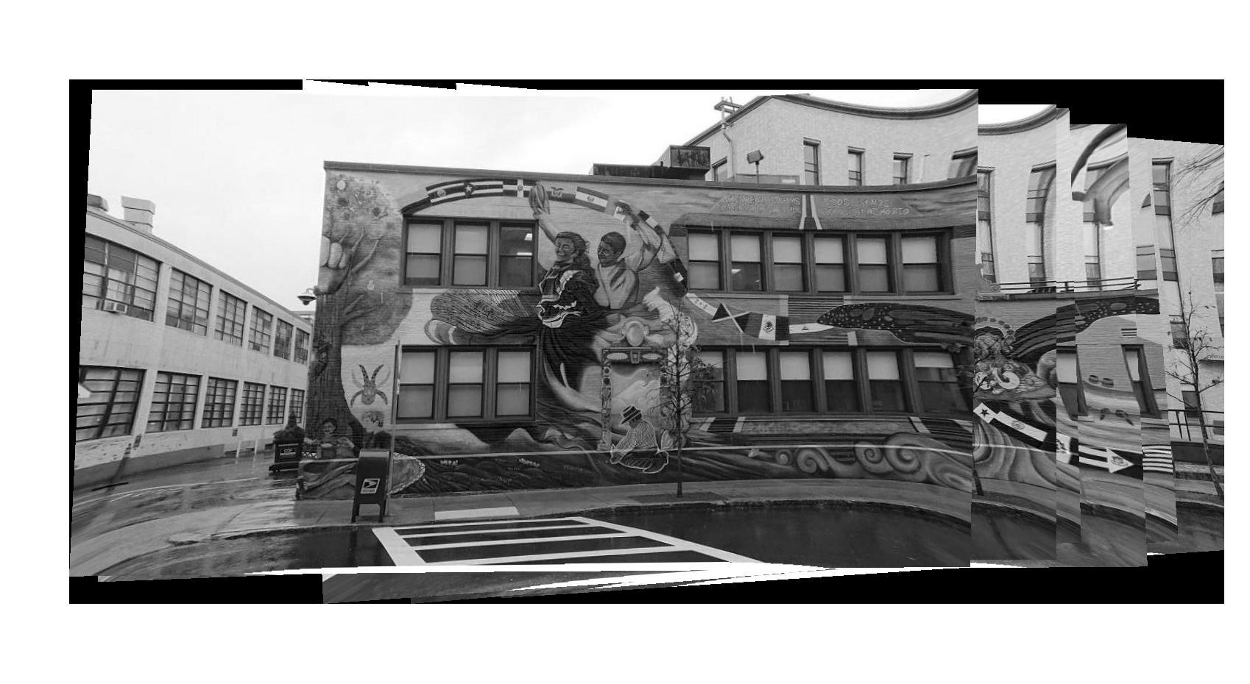
Composite mosaic with undistorted images
Composite mosaic with undistorted images
The edge did not match because for undistorting the center of the image, the edge part will curve.

Slide 12
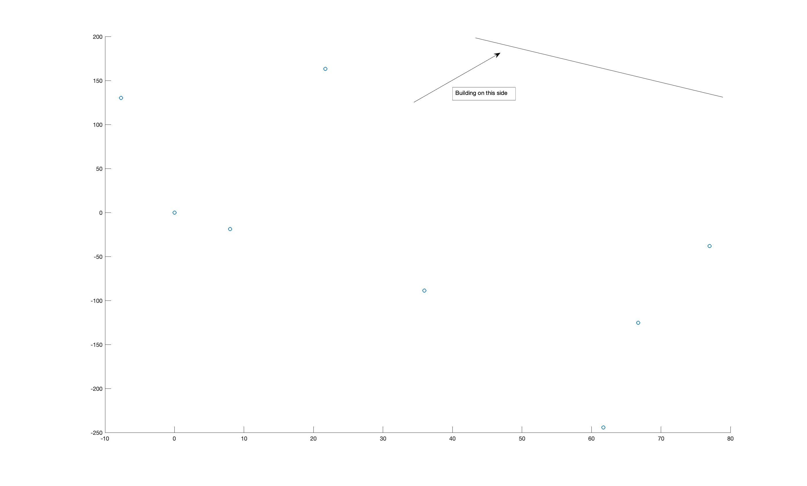
Position of the camera estimate by compositing the images
The position are estimated by tform which use to generate the composition image
The point is not in line because the shooting angle is not is same angle
Position trans by trans.m

Slide 13
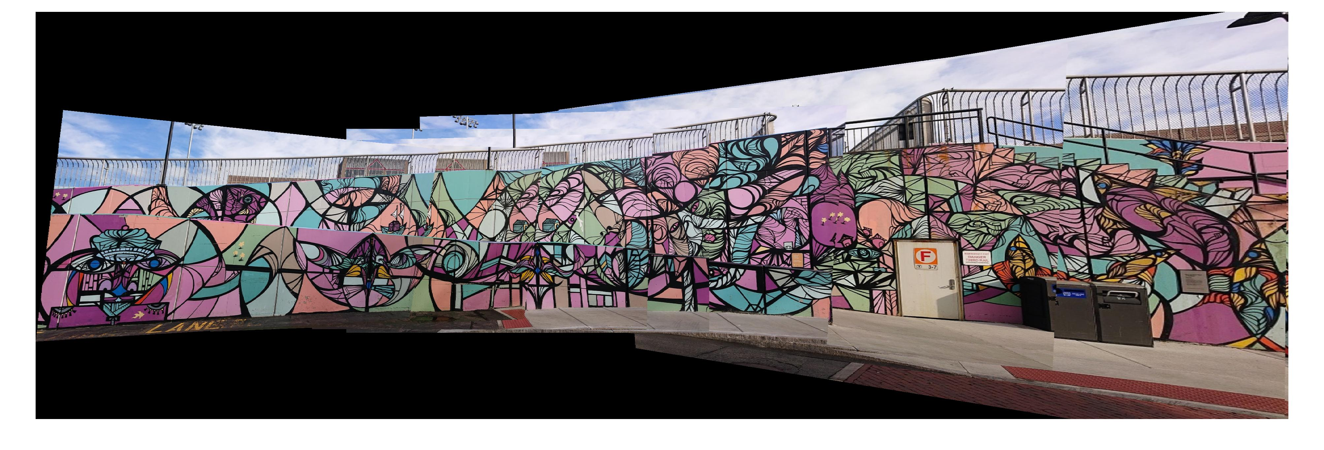
Composite mosaic – Near T line
The composition of graffiti near T line
These images overlapping more than 50%
Composite with 12 images
With harris.m collecting 2000 points for each image

Slide 14
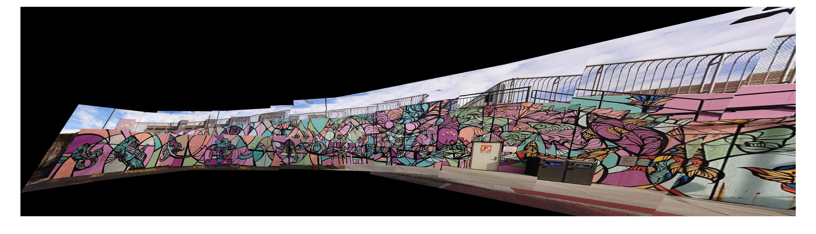
Composite mosaic – Near T line
More match points
Harris.m with 8000 points for each images

Slide 15
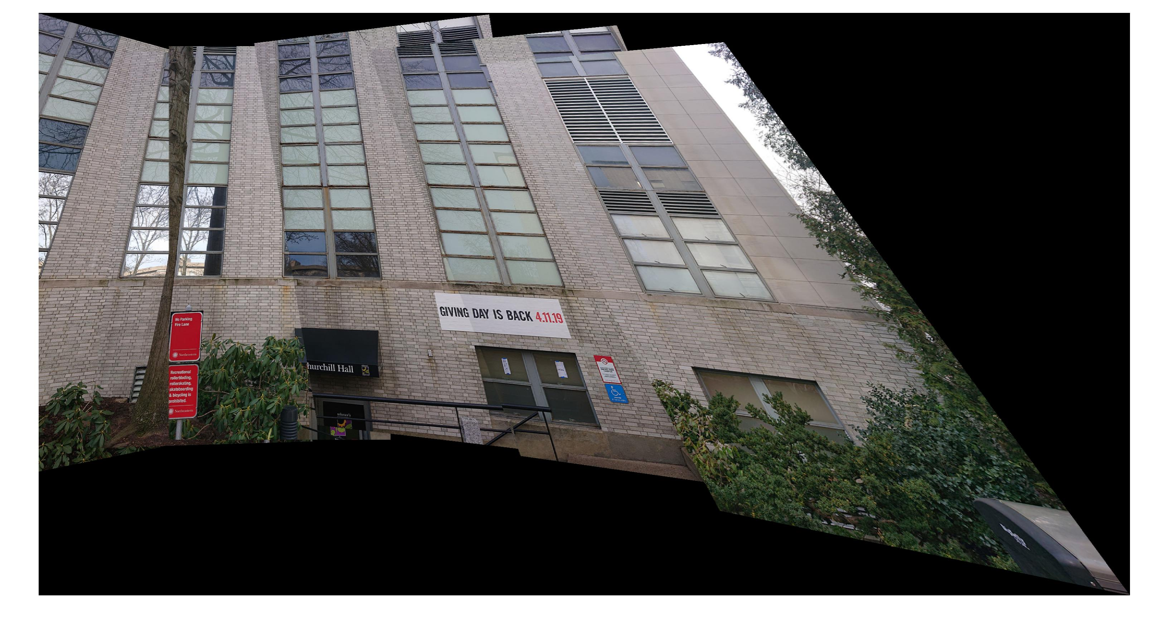
Images of the Churchill Hall
Image from outside of Churchill Hall
Mapping by harris.m with collecting 8000 points of each images
5 Image in total
The overlapping is near to 15 %, and the composition works okay

